Slide 1

Building a scalable web application on aws
Leveraging AWS Services for Scalability and Performance

Slide 2
introduction
Utilize various AWS services to meet your application's specific needs. For example, use Amazon S3 for media streaming or Amazon EBS for storage, Amazon RDS for databases and EC2 for hosting the webpage.

Slide 3
Architecture overview
Design and deploy a scalable web application on Amazon Web Services (AWS) utilizing various AWS services.
The aim is to create a robust architecture capable of handling varying levels of traffic while maintaining high availability, reliability, and performance.

Slide 4
Compute (ec2)
EC2 provisioning, Auto Scaling, and Elastic Load Balancing are key components of building scalable applications in the AWS cloud. EC2 allows you to create and manage virtual servers with specific configurations. Auto Scaling automatically adjusts the number of instances based on demand, optimizing resource allocation. Elastic Load Balancing distributes traffic across multiple instances, ensuring high availability and fault tolerance. By combining these services, you can provision instances as needed, scale up or down based on demand, and evenly distribute traffic, enabling your application to handle varying levels of traffic while maintaining performance.

Slide 5
Storage (S3)
S3 (Simple Storage Service) is a scalable and reliable object storage service offered by AWS. It is commonly used for storing static assets like images, videos, and documents. Two important features of S3 are versioning and lifecycle policies. Versioning allows you to keep multiple versions of an object, providing backup and recovery capabilities. Lifecycle policies automate object management based on defined rules, allowing you to transition objects between storage classes or delete them after a certain period. Combining versioning and lifecycle policies ensures the durability and cost efficiency of static assets in S3, making it a reliable solution for cloud storage.

Slide 6
Setting up and configuring an S3 bucket involves several steps:
Create an S3 bucket: In the AWS Management Console, navigate to the S3 service and click on "Create bucket." Provide a unique name for your bucket and select the desired region for data storage.
Configure bucket properties: Set the bucket properties according to your requirements. This includes enabling or disabling features like versioning, logging, and server access logging.
Set up bucket permissions: Define access control for your bucket. You can configure bucket-level access policies using AWS Identity and Access Management (IAM) to manage user permissions and control who can access the bucket and perform operations.
Enable CORS (Cross-Origin Resource Sharing): If your bucket needs to serve resources to web pages hosted on different domains, you can configure CORS to control cross-origin requests.
Set up bucket encryption: Enable server-side encryption to protect your data at rest. You can choose to use AWS Key Management Service (KMS) or Amazon S3 managed keys for encryption.
Configure lifecycle policies: Use lifecycle policies to automate object management. For example, you can specify rules to transition objects to different storage classes or delete them after a certain period of time.
Enable logging and monitoring: Enable access logging for your bucket to track requests and activities. You can also set up event notifications to trigger actions when specific events occur, such as object creation or deletion.
Fine-tune performance and scalability: You can configure options like Transfer Acceleration to optimize data transfer speed, and enable static website hosting if you want to serve static web content directly from your bucket.
Apply best practices and security measures: Follow AWS security best practices, such as implementing strong IAM policies, regularly reviewing bucket permissions, and enabling MFA (Multi-Factor Authentication) delete protection.
Test and validate: Once the bucket setup is complete, test the configurations and permissions to ensure that the bucket is functioning as expected and that access controls are properly enforced.

Slide 7
Database (aws rds)
RDS (Relational Database Service) and DynamoDB are two AWS database services that serve different needs. RDS offers scalable, managed relational databases for structured data, while DynamoDB provides a fully managed NoSQL database for semi-structured or unstructured data. RDS is suitable for applications requiring complex queries and ACID compliance, while DynamoDB excels in high scalability and low-latency performance. Factors to consider when choosing between them include data model, scalability, performance, cost, and database management responsibilities. RDS is commonly used for transactional apps, content management systems, and data warehousing, while DynamoDB is popular for real-time bidding, gaming, mobile apps, and IoT applications.

Slide 8
Data replication and backup strategies are essential for ensuring data durability, availability, and recovery in AWS RDS and DynamoDB.
For AWS RDS:
Data replication includes Multi-AZ replication for high availability and synchronous data replication to a standby replica in a different AZ. Read replicas allow for scaling read-intensive workloads.
Backup strategies involve automated backups with configurable retention periods and the ability to restore to any point in time. Manual snapshots provide additional flexibility for long-term backups and database changes.
For AWS DynamoDB:
Data replication is achieved through global tables for multi-region replication and DynamoDB Streams for capturing and replicating changes in real-time.
Backup strategies include on-demand backups stored in Amazon S3, which can be restored to a new table or rolled back to a previous state. Time-point recovery allows restoring a table to any specific point within the last 35 days.
Combining strategies like Multi-AZ deployment, read replicas, automated backups, and cross-region replication enhances data durability, availability, and disaster recovery capabilities.
Overall, data replication and backup strategies in both RDS and DynamoDB are crucial for maintaining data integrity, minimizing downtime, and facilitating data recovery in case of failures or disasters.

Slide 9
Networking (vpc)
VPC setup involves creating a virtual network within AWS, defining IP address ranges, configuring subnets, routing tables, and security settings. It provides a secure and isolated environment for AWS resources.
Route 53 DNS routing is an AWS service for managing domain names and routing traffic to different resources based on routing policies. It enables efficient DNS resolution and helps in directing traffic to the appropriate destinations.
CloudFront CDN is a content delivery network service that accelerates the delivery of web content to users worldwide. It caches content at edge locations, reducing latency and improving performance.

Slide 10
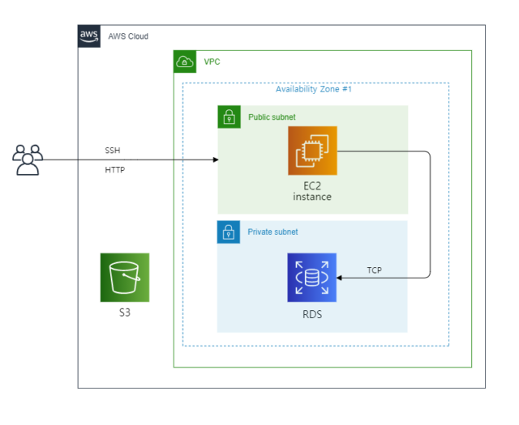

Slide 11
Implementation details
Architecture Design.
Database Scaling.
Caching and Content Delivery.
Testing and Deployment

Slide 12
Highlights of challenges faced during implementation.
The challenges of load balancing involve distributing incoming traffic across multiple servers or instances to achieve scalability. It requires implementing a load balancer that efficiently handles traffic, which can be complex due to considerations such as session management, health checks, and distribution algorithms.
State management in a distributed environment is another challenge, especially when it comes to managing user sessions and maintaining state. Overcoming this challenge involves implementing stateless components and utilizing technologies like sticky sessions or session data storage.
Monitoring and auto-scaling are crucial for dynamically adjusting resources based on traffic patterns and demand. However, implementing effective monitoring and auto-scaling mechanisms can be complex. It requires configuring monitoring tools and defining appropriate scaling policies to ensure optimal resource allocation.

Slide 13
Scalability and performance testing
When building a scalable website, load testing and performance monitoring are essential to ensure optimal performance under varying levels of traffic.
By conducting load testing and monitoring performance metrics, you can identify bottlenecks, optimize system components, and ensure that your website can handle expected traffic volumes while maintaining optimal performance. Regular load testing and monitoring are crucial as the website evolves and experiences changes in traffic patterns.

Slide 14
Key findings and accomplishments
When building a scalable website, there are several key findings and accomplishments that can be achieved. Here are some examples:
One of the primary accomplishments is successfully achieving scalability. This means that the website can handle increased traffic, user load, and data volume without experiencing performance degradation or system failures.
High Availability and Resilience: Building a scalable website often involves implementing high availability and resilience measures. By utilizing redundant infrastructure, implementing failover mechanisms, and employing disaster recovery strategies, the website can remain accessible and functional even during server or component failures.

Slide 15
conclusion
The key findings and accomplishments when building a scalable website revolve around achieving scalability, optimizing performance, ensuring high availability, efficient resource utilization, delivering a seamless user experience, cost optimization, and embracing a mindset of continuous improvement.
Building a scalable website is a complex task that involves various considerations. It requires careful planning, continuous optimization, proactive monitoring and leveraging cloud infrastructure and automation. By learning from past experiences and considering future needs, you can create a website that can handle increasing loads, deliver optimal performance and support business growth.

Slide 16
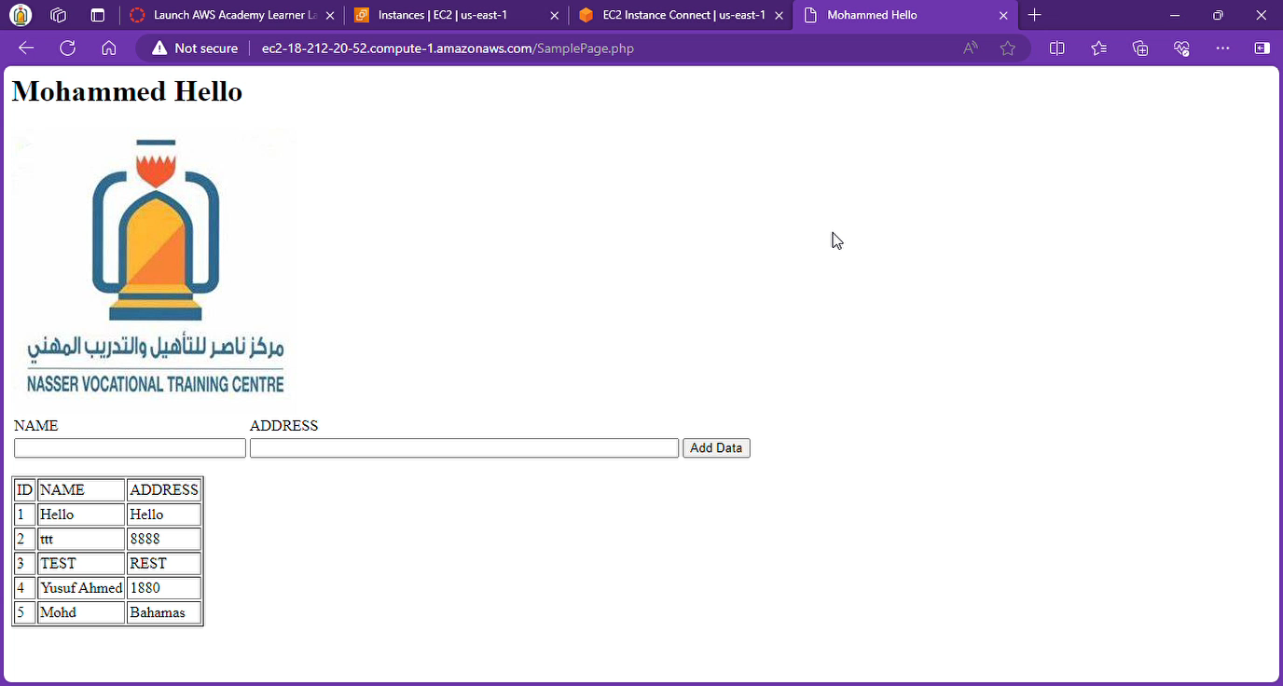
Short video

